Slide 1
Travel Agency Management System
Team Name: Mind Ink Bots
Dipti Dubey
Parth Joshi
Prasanna Pimparwar
Shivani Vats

Slide 2
INTRODUCTION
A system that automates the processes and activities of a travel agency.
Capture customer’s personal information and preferences for travel bookings and record the details of the final bookings made by the customers.
Generate reports to facilitate ease in making travel decisions and preferences.
To eliminate the broker fee and provide affordable deals to our customers.
Provide an online booking system that allows the customers to check their reservations and know the status of the bookings from a convenient location at their own ease.

Slide 3
Problem Statement
Today, the world of data is constantly evolving every minute and has created a completely new dimension of challenges for both customers and agents across the globe to accurately record, store, update, and track data on a regular basis.
A customer has to approach various agencies to find details of places and book hotels. This requires a lot of time and effort, may not fetch desired information from these agencies and often be misguided.
Hence, it becomes tedious for a customer to plan a journey and have it executed properly since travel agencies cannot always possess optimal bookings to satisfy the customer needs.
Thus, our aim here is to design a model that provides a hassle-free experience for booking a travel destination, maintain accurate user preferences and curate optimum travel packages

Slide 4
Proposed Solution
We, the Mind Ink Bots, have brainstormed to come up with a database design that brings out the user-friendly aspect of the entire hotel booking process.
The database design allows us to sort the hotels on the basis of sentiment analysis conditional to the past customer reviews, which will be managed by the BOOKING and REVIEW ENTITY in our model.
This database design enables one to infer or obtain the User and Hotel details by just including their auto-generated UNIQUE IDs, which in our case would be the PRIMARY KEY.
Also, the database has been designed in a manner that caters to delivering optimum travel packages since the role of the agent has been entirely eliminated.
Unlike the travel agencies prevalent in the market, our clients have the privilege and flexibility to book any hotel within the proximity of their favorite travel attraction

Slide 5
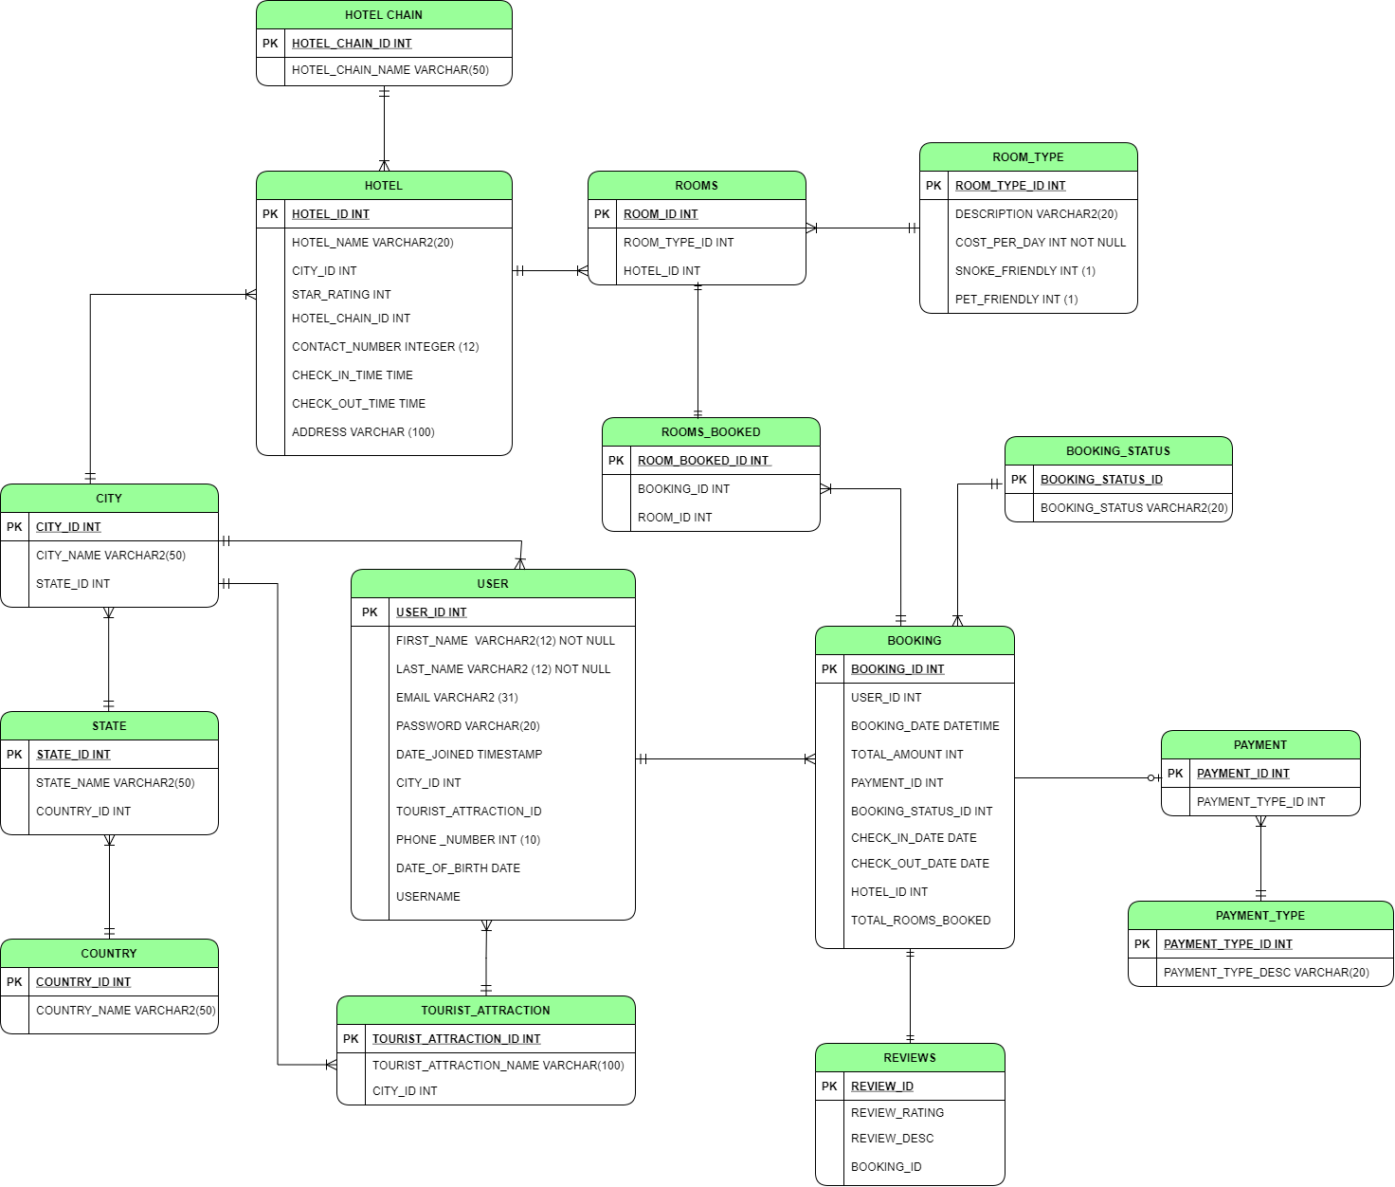
ER DIAGRAM

Slide 6
Features
DDL
DML
PL/SQL PROCEDURE
PACKAGES
CUSTOM VIEWS
TRIGGERS
INDEXES
USER ROLES
REPORTS

Slide 7
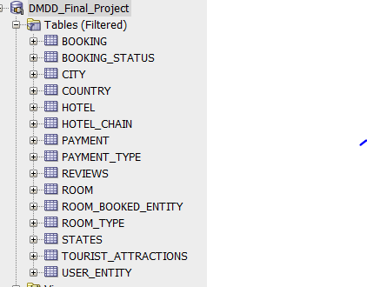
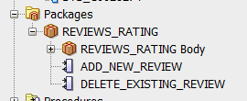
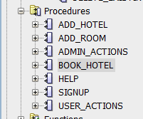
Database Objects

Slide 8

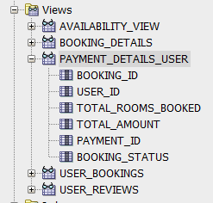

Slide 9
DEMO

Slide 10
THANK YOU

